Slide 1
Computer
Introduction to computer

Slide 2
Functions of computer
Computer is a data processing device that performs four major functions: input, process, output, and storage”
2) There are basically for basic functions of computers - input, storage, processing and output.
These are 1) it accepts data or instructions by way of input,
2) it stores data,
3) it can process data as required by the user,
4) it gives results in the form of output, and
5) it controls all operations inside a computer.

Slide 3
Generation of computers
First generation
Second generation
The first generation of computers is generally known as electromechanical computers or using vacuum tubes. For example, ENIAC has used Vacuum tubes, relied on Machine Language and Boolean logic. A computer using vacuum tubes is very slow in executing programs compared to present-day computers.
A transistor computer often referred to as a second-generation computer, is a type of computer that, as opposed to vacuum tubes, relies on discrete transistors as its principal component to do the processing.

Slide 4
Third and forth generation of computers
Third generation
Forth generation
Third-generation computers used integrated circuits in place of transistors. With the use of integrated circuits, these computers became reliable, generated less heat, were small in size, fast, very less maintenance, and were inexpensive. It was developed in 1958 by Robert Noyce and Jack Kilby.
The fourth generation lasted from 1971 to 1980.On a single chip the width of a fingernail, thousands of components were crammed. It resulted in the invention of the microprocessor. Semiconductor memories have taken the place of magnetic core memory. During this time, computer operating institutions were designed.

Slide 5
Fifth generation of computers
Japan invented the FGCS in 1982, a type of fifth-generation computer with high computing power that uses microelectronic technology. The fifth gen of computers is the most recent and advanced computers. These computers use programming languages such as Python, R, C#, Java, etc., as input methods.

Slide 6
First generation
Second generation
Fifth generation
Third generation
Forth generation

Slide 7
History of computer
In the early 1820s, Charles Babbage created the Difference Engine. It was a mechanical computer that could do basic computations. It was a steam-powered calculating machine used to solve numerical tables such as logarithmic tables. Charles Babbage created another calculating machine, the Analytical Engine, in 1830.

Slide 8
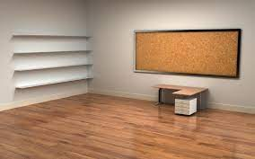
Computer hardware
Input device
The most common input devices are the keyboard, mouse, and touch screen. Portable keyboard, wireless mouse, and iPhone. There are hundreds of other input devices, like microphones to capture sound waves, scanners to capture image data, and virtual reality devices to capture our body movements.

Slide 9
Difference between mouse and keyboard
mouse
keyboard
resemblance to the rodent. The earliest known written use of the term mouse or mice in reference to a comp .A computer mouse is named for its outer pointing device is in Bill English's July 1965 publication, "Computer-Aided Display Control".
A computer keyboard is an input device used to enter characters and functions into the computer system by pressing buttons, or keys. It is the primary device used to enter text. A keyboard typically contains keys for individual letters, numbers and special characters, as well as keys for specific functions .

Slide 10
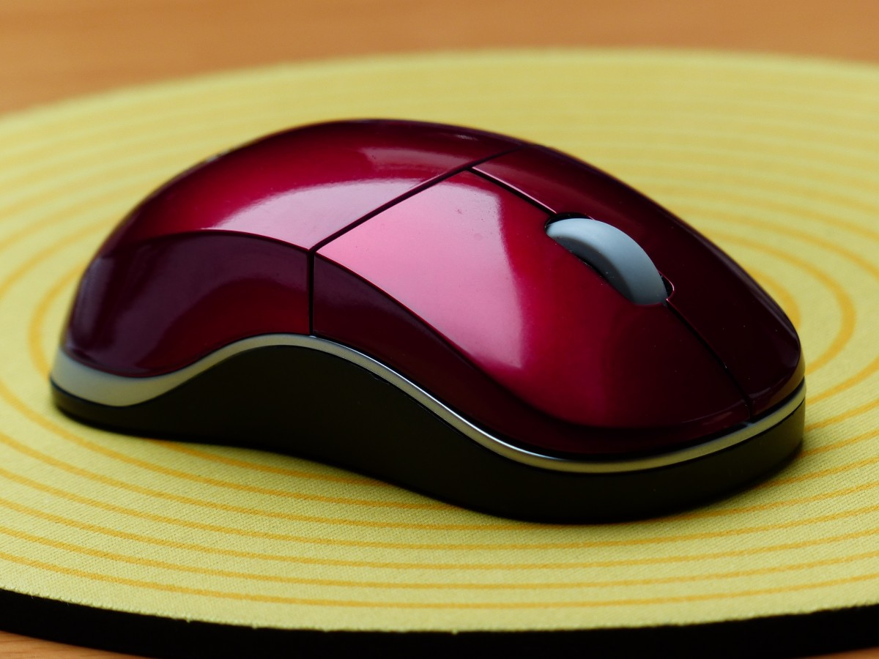
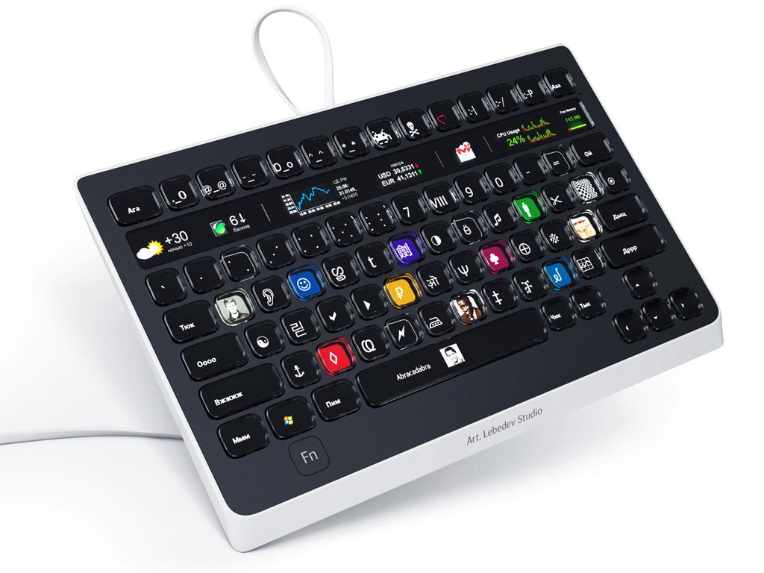
Picture of mouse and keyboard

